Slide 1
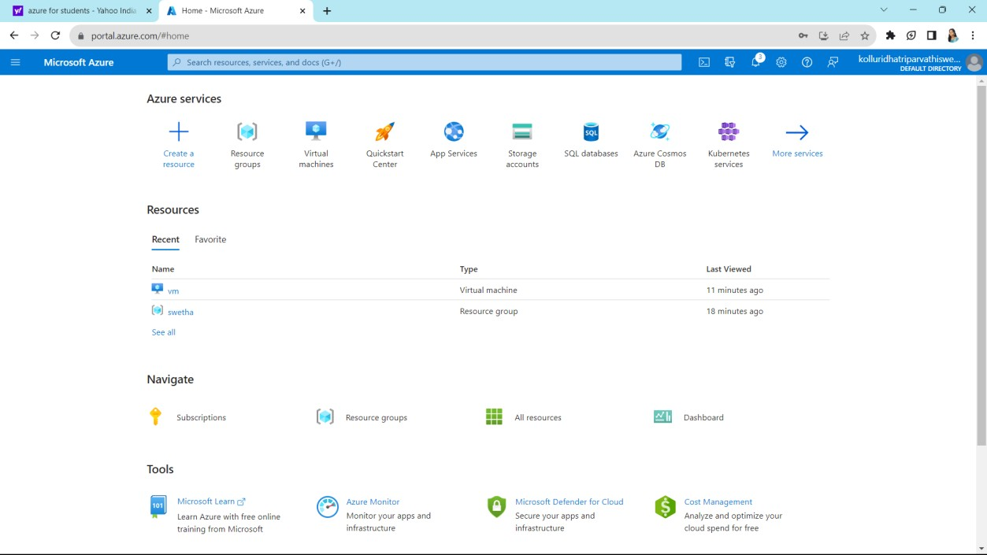
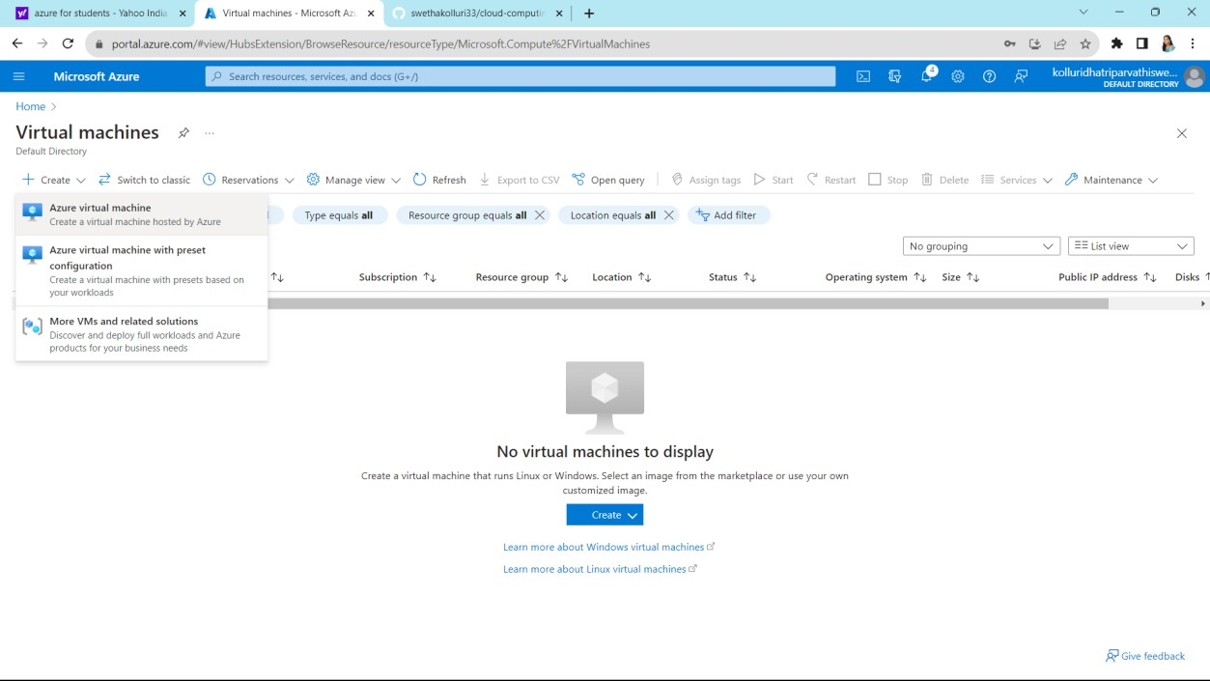
EXPERIMENT 12
Demonstrate Infrastructure as a Service (IaaS) by creating a Virtual Machine using a Public Cloud Service Provider (Azure), configure with required memory and CPU.
first we can sign in into Azure
home page will appears like this now click on virtual machines
Now click on virtual machines select azure virtual machine and then click on create

Slide 2
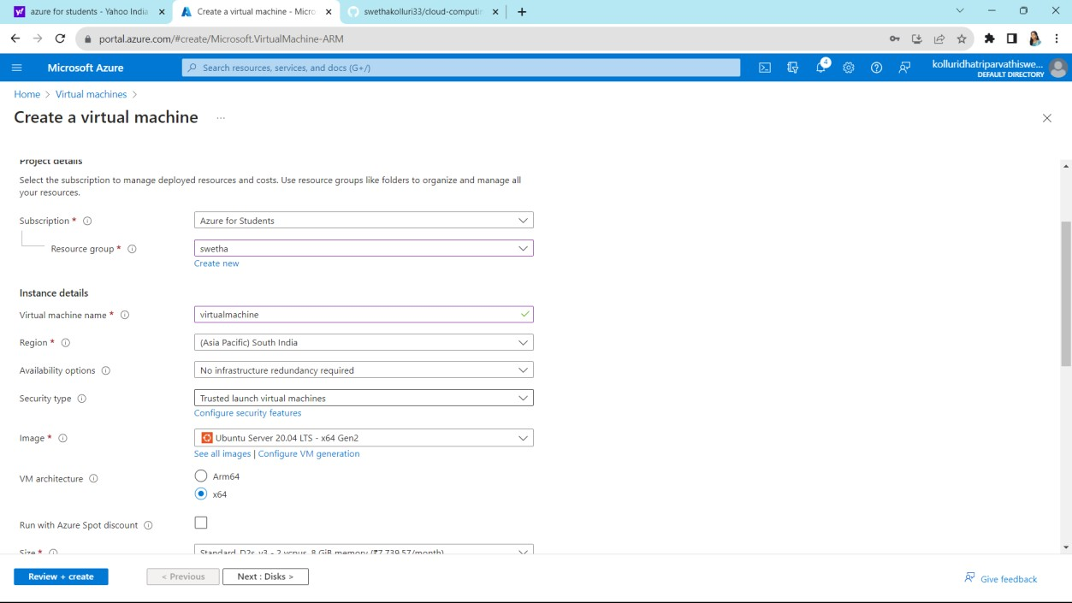
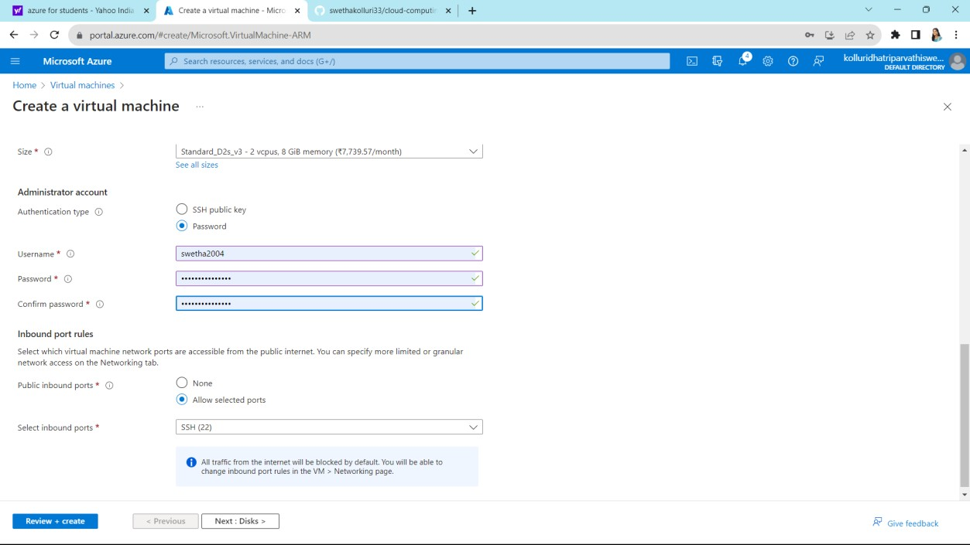
Fill up the requirements
Select password and give a strong password after that click on next

Slide 3
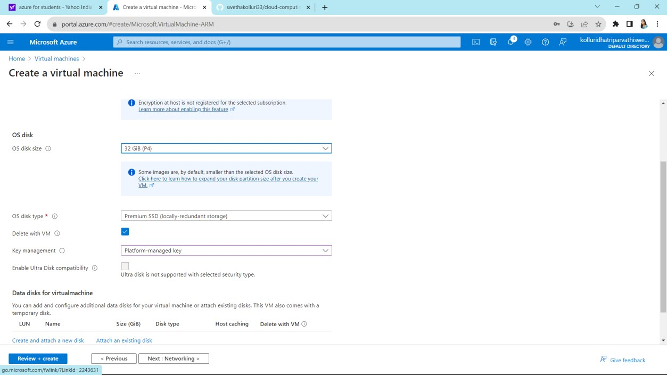
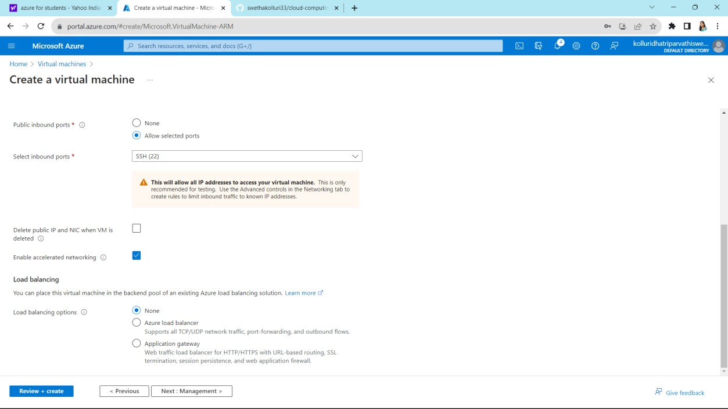
Click on next
Check the details and click on next

Slide 4
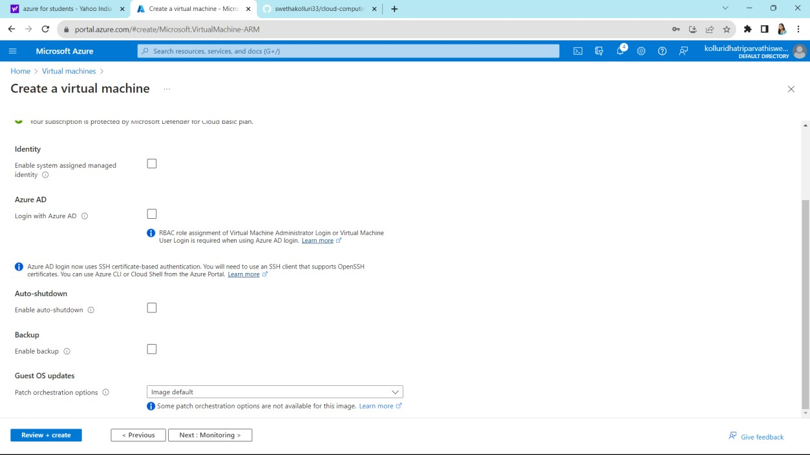
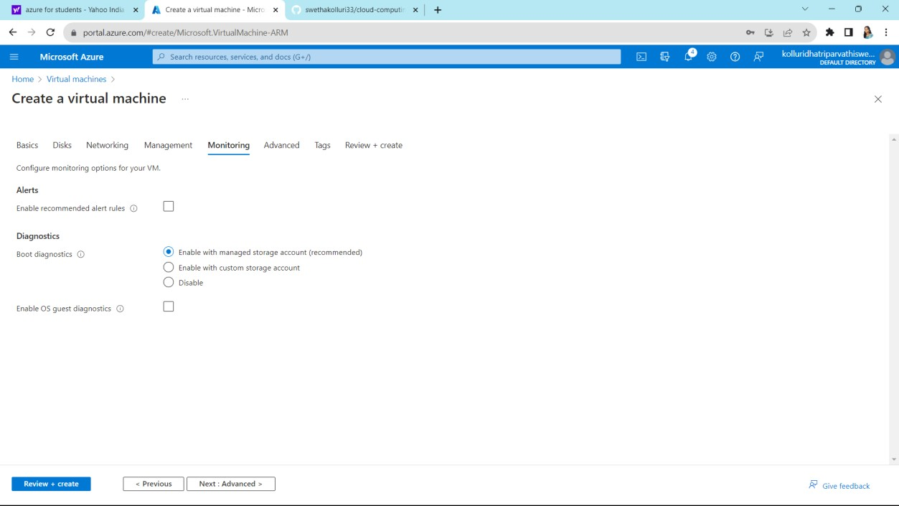
Click on next
Click on next

Slide 5
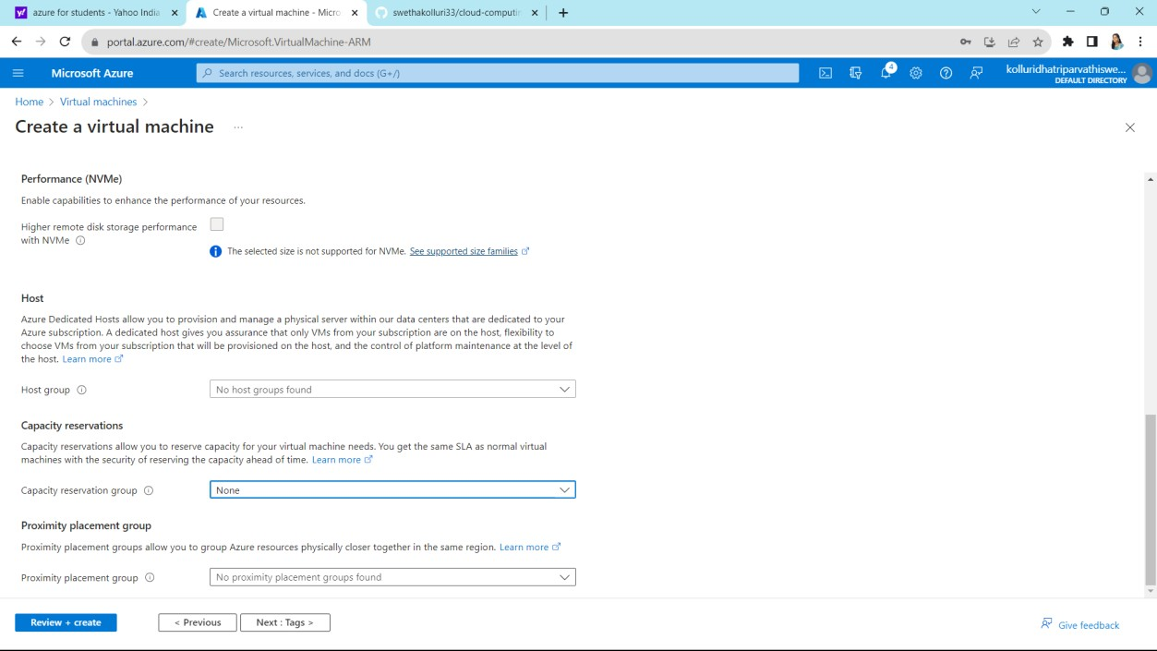
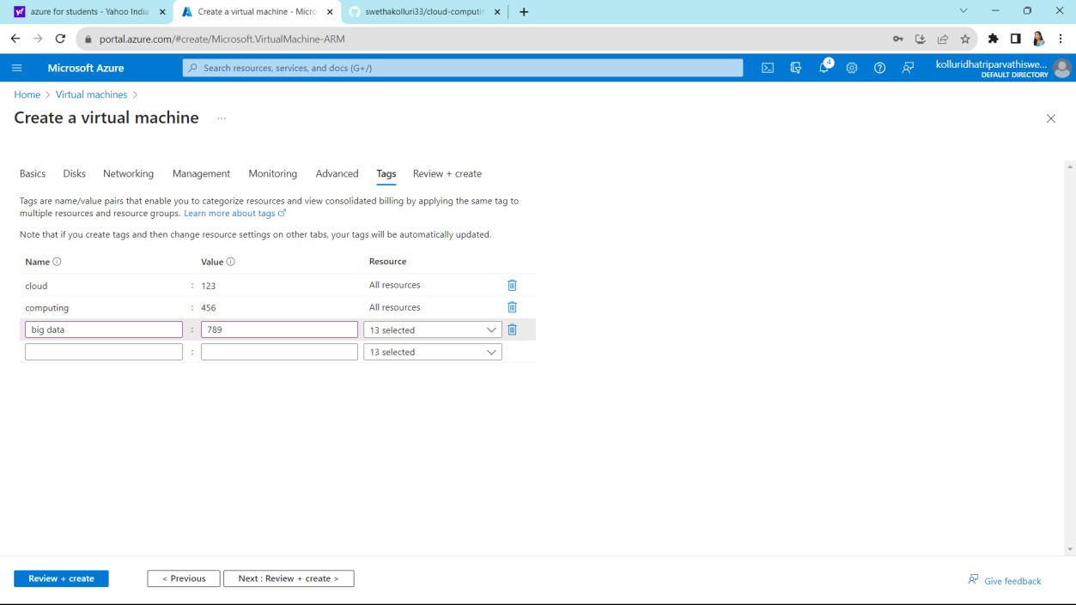
Click on next
Give some names and values and click on next

Slide 6
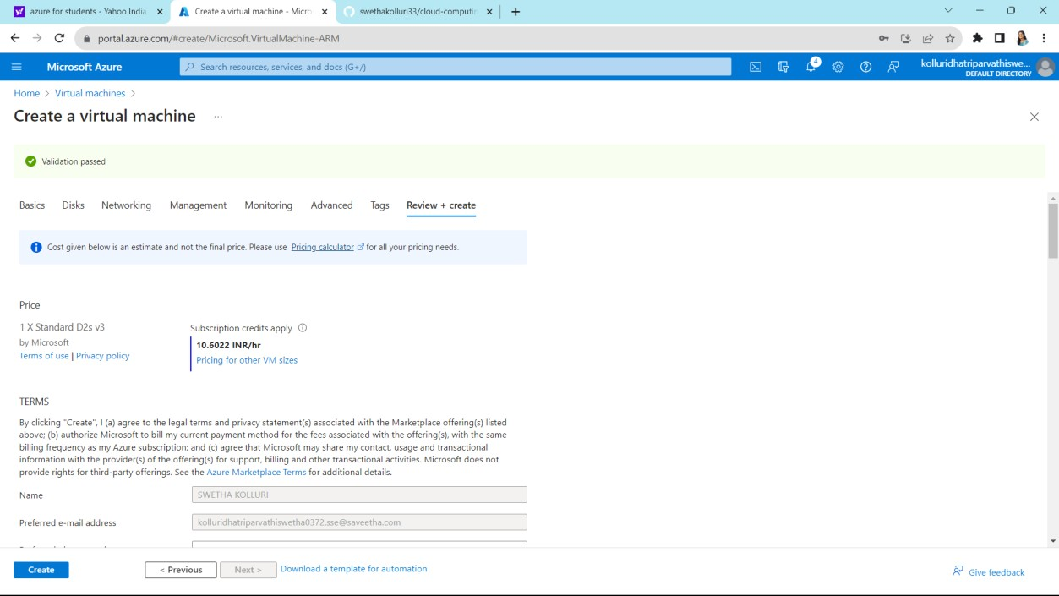
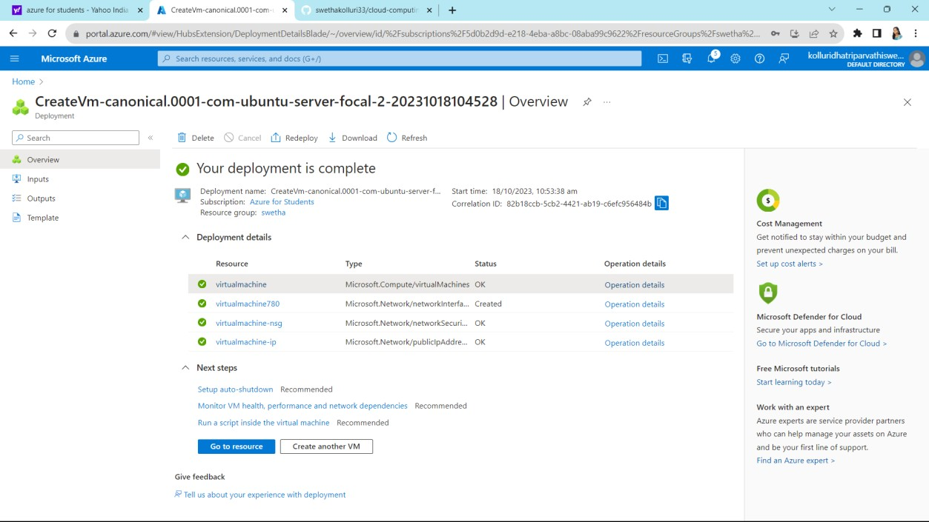
Click on create which is on left side bottom
Click on got resources

Slide 7
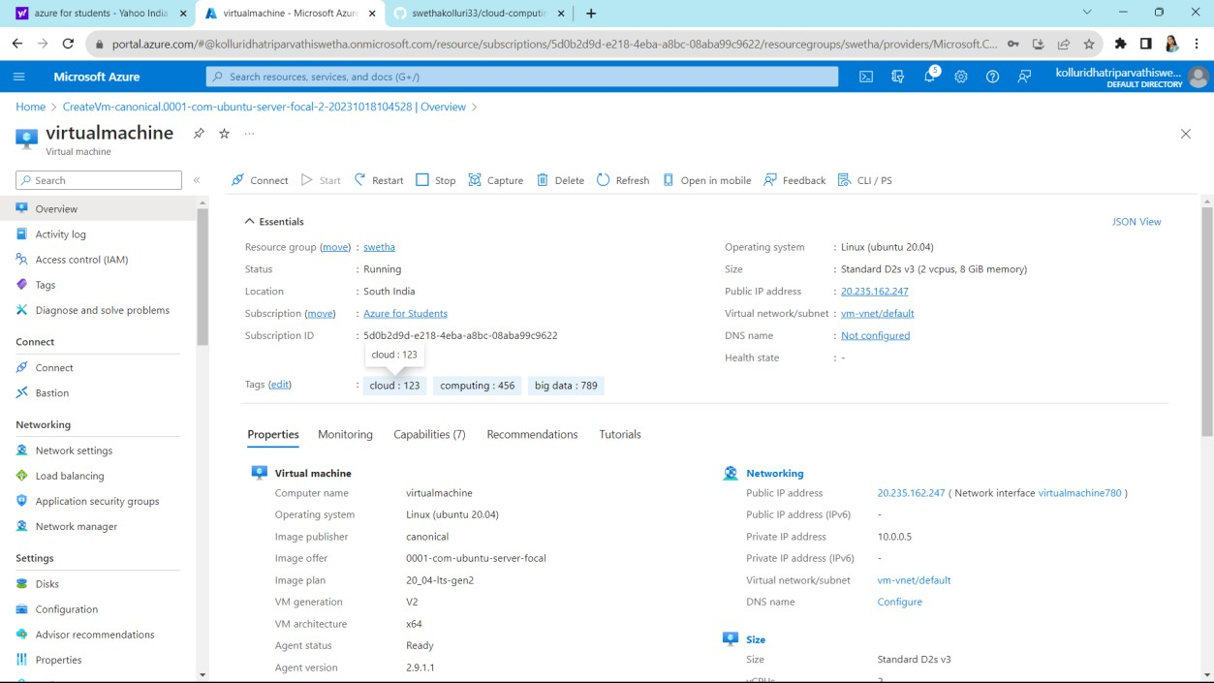
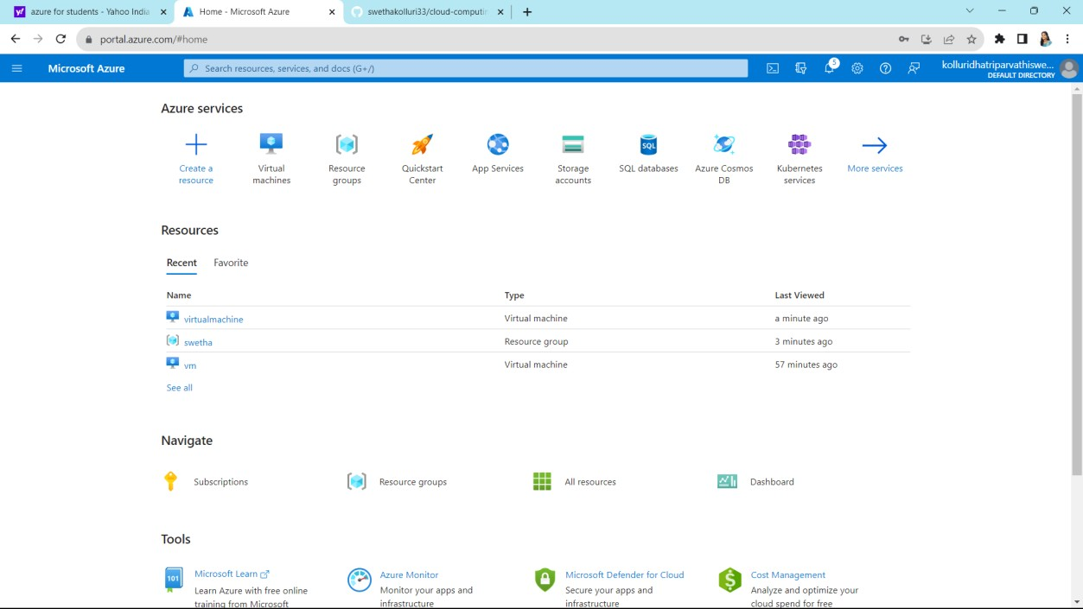
It shows all you listed before
Go to home created virtual machine is appears at home page

